Slide 1
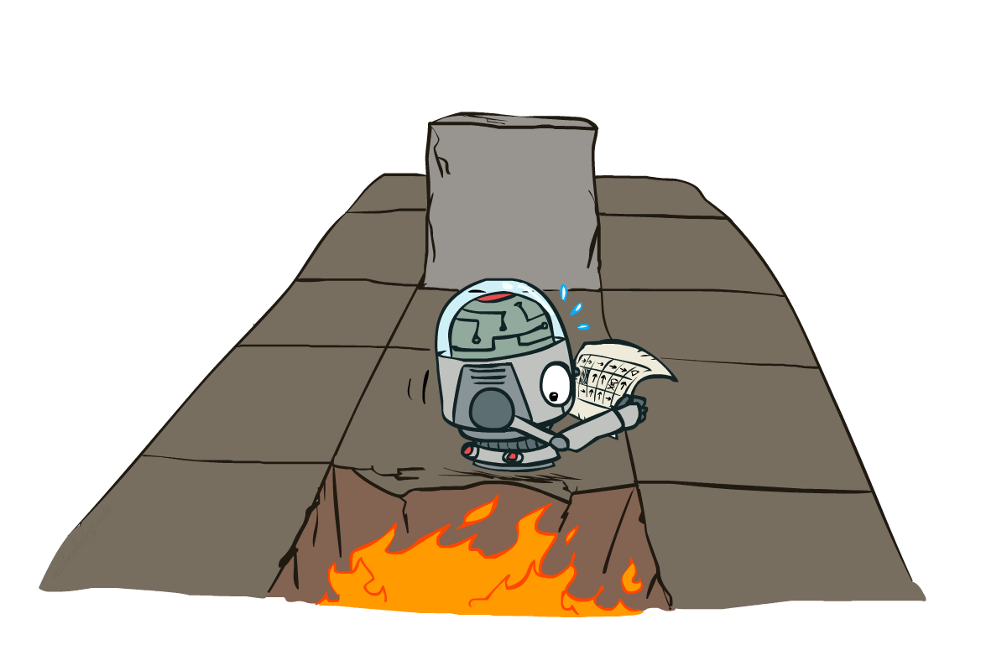
Markov Decision Processes -wrapup
Slides courtesy of Dan Klein and Pieter Abbeel --- University of California, Berkeley
[These slides were created by Dan Klein and Pieter Abbeel for CS188 Intro to AI at UC Berkeley. All CS188 materials are available at http://ai.berkeley.edu.]
Notes:
Please retain proper attribution, including the reference to ai.berkeley.edu. Thanks!

Slide 2
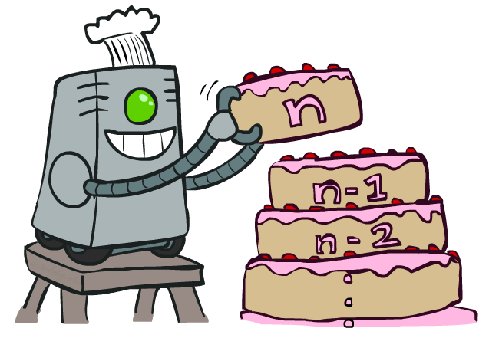
Review: Value Iteration
Notes:
That’s an algorithm called value iteration. You can think of this as building your value from the bottom up. It will behave similarly to expectimax, but will be a lot less work, when we only have a small number of states. Let’s see how it works.

Slide 3
Review: Value Iteration
Start with V₀(s) = 0: no time steps left means an expected reward sum of zero
Given vector of V_{k}(s) values, do one ply of expectimax from each state:
Repeat until convergence
Complexity of each iteration: O(S²A)
Theorem: will converge to unique optimal values
Basic idea: approximations get refined towards optimal values
Policy may converge long before values do
V_{k+1}(s)
a
s, a
s,a,s’
V_{k}(s’)
Notes:
We are changing the equation by simply changing the equals sign to be an assignment.
We are going to store all of the V values in a vector. For V_0, everything is just 0.
The recursion is into an Expectimax tree that we have already computed. The recursion won’t actually happen because we’ve already got it.
What will this actually do? We can go from 0, to 1 to 2, to K. Each time we will go deeper into the tree. When should we stop? When the values start to converge.
Complexity = we do this update for each state, then we do a little expectimax. We do a for loop over A to take take a max over each action, then we do another for loop that goes over each state again. So the complexity is S*A*S or S^2*A.

Slide 4
Review: Problems with Value Iteration
Value iteration repeats the Bellman updates:
Problem 1: It’s slow – O(S²A) per iteration
Problem 2: The “max” at each state rarely changes
Problem 3: The policy often converges long before the values
s
a
s, a
s,a,s’
s’
Notes:
[Re-iterate the problems.]
So what can we do?

Slide 5
Policy Iteration
Alternative approach for optimal values:
Step 1: Policy evaluation: calculate utilities for some fixed policy (not optimal utilities!) until convergence
Step 2: Policy improvement: update policy using one-step look-ahead with resulting converged (but not optimal!) utilities as future values
Repeat steps until policy converges
This is policy iteration
It’s still optimal!
Can converge (much) faster under some conditions
Notes:
We’re going to look at an alternate called policy evaluation.
Policy improvement is the process of updating the policy with a one step look ahead on the utilities as feature values.

Slide 6
Policy Iteration
Evaluation: For fixed current policy π, find values with policy evaluation:
Iterate until values converge:
Improvement: For fixed values, get a better policy using policy extraction
One-step look-ahead:
Notes:
If we wrote this out in equation, it would look like this.
Step 1 is evaluation. I do this simplified update where UNLIKE VALUE ITERATION I don’t max over the actions. I only do the averaging on the chance nodes. It’s fast, since I don’t consider all of the actions. I do this until it convergences.
Step 2 is the improvement to the policy. I do one layer of expectimax. Our truncation function is the OLD POLICY. That’s a bit weird right? I’m pushing the old stuff one step into the future and thereby make progress.
If you think about this, the improvement step is just like value iteration. So it’s not going to be very fast. All of the speed gains come from the evaluation step. So we run that many times before allowing an improvement step. Step 2 is the only place where the policy changes.

Slide 7
Comparison
Both value iteration and policy iteration compute the same thing (all optimal values)
In value iteration:
Every iteration updates both the values and (implicitly) the policy
We don’t track the policy, but taking the max over actions implicitly recomputes it
In policy iteration:
We do several passes that update utilities with fixed policy (each pass is fast because we consider only one action, not all of them)
After the policy is evaluated, a new policy is chosen (slow like a value iteration pass)
The new policy will be better (or we’re done)
Both are dynamic programs for solving MDPs
Notes:
OK, let’s compare them. They do the same thing. Both take in an MDP. They both output an optimal quality. On the surface they both output optimal values. But they also compute the optimal policy. Policy iteration explicitly outputs the optimal policy, value iteration does it implicitly.
Both are the same class of things. They are dynamic programs for solving MDPs.

Slide 8
Summary: MDP Algorithms
So you want to….
Compute optimal values: use value iteration or policy iteration
Compute values for a particular policy: use policy evaluation
Turn your values into a policy: use policy extraction (one-step lookahead)
These all look the same!
They basically are – they are all variations of Bellman updates
They all use one-step lookahead expectimax fragments
They differ only in whether we plug in a fixed policy or max over actions
Notes:
These are all Bellman equations turned into a one step look ahead.

Slide 9
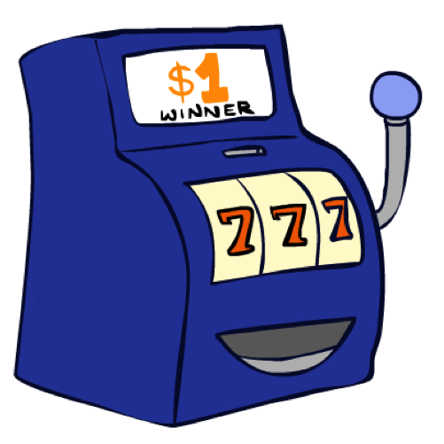
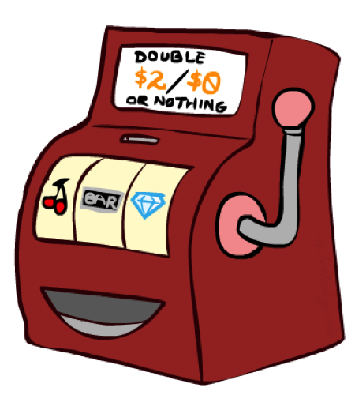

Double Bandits
Notes:
one-armed bandit A slot machine, as in It's amazing how many people think they can make money playing a one-armed bandit. This term refers to both appearance and function: the operating lever looks like an arm, and the machine in effect robs players, since it “wins” and keeps the player's money in an overwhelming majority of instances

Slide 10
Double-Bandit MDP
Actions: Blue, Red
States: Win, Lose
No discount
100 time steps
Both states have the same value
0.25 $0
0.75
$2
W
L
0.25
$0
$1
1.0
$1
1.0
0.75 $2

Slide 11
Offline Planning
Solving MDPs is offline planning
You determine all quantities through computation
You need to know the details of the MDP
You do not actually play the game!
No discount
100 time steps
Both states have the same value
0.25 $0
Value
0.75
$2
W
0.25
$0
Play Red
150
L
$1
1.0
$1
1.0
0.75 $2
Play Blue
100

Slide 12
Let’s Play!
$2
$2
$0
$2
$2
$2
$2
$0
$0
$0
Notes:
What actually happens? We actually won real fake money, instead of just thinking about it. We won $12 for 10 plays. Instead of our estimate of $15.

Slide 13
Online Planning
Rules changed! Red’s win chance is different.
?? $0
??
$2
W
L
??
$0
$1
1.0
$1
1.0
?? $2
Notes:
Now we aren’t given the probabilities. Red has a payoff but you don’t know what it is.
We don’t know the MDP! We can’t calculate its values. So what should we do? Give up and go home? No, let’s try it out by playing.

Slide 14
Let’s Play!
$0
$0
$0
$2
$0
$2
$0
$0
$0
$0
Notes:
Who wants to play red? Do we know that’s the optimal policy? What should we play? Red! Red! Red! When should we stop?
This is a different setting. Red is an MDP. It has a payoff. You don’t know what it is.
What you have to do is an optimal amount of discovery mixed in with not losing your money.

Slide 15
What Just Happened?
That wasn’t planning, it was learning!
Specifically, reinforcement learning
There was an MDP, but you couldn’t solve it with just computation
You needed to actually act to figure it out
Important ideas in reinforcement learning that came up
Exploration: you have to try unknown actions to get information
Exploitation: eventually, you have to use what you know
Regret: even if you learn intelligently, you make mistakes
Sampling: because of chance, you have to try things repeatedly
Difficulty: learning can be much harder than solving a known MDP
Notes:
Difficulty: In the original case, it was instantly obvious that you should always play red. Here your lack of knowledge makes it much more difficult to figure out the optimal policy.

Slide 16

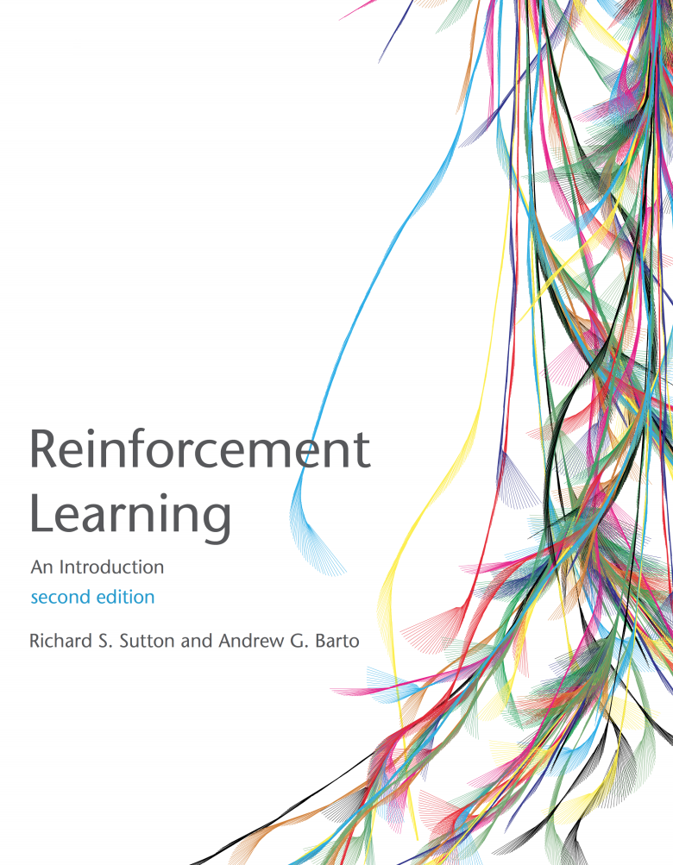
Reinforcement Learning
Read AIMA 21
Also read Sutton and Barton Chapter 6.1, 6.2 and 6.5 (see link on course web site)

Slide 17
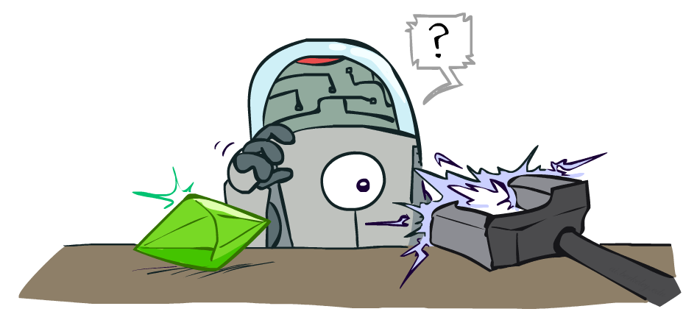
Reinforcement Learning
Slides courtesy of Dan Klein and Pieter Abbeel --- University of California, Berkeley
[These slides were created by Dan Klein and Pieter Abbeel for CS188 Intro to AI at UC Berkeley. All CS188 materials are available at http://ai.berkeley.edu.]
Notes:
Please retain proper attribution, including the reference to ai.berkeley.edu. Thanks!

Slide 18
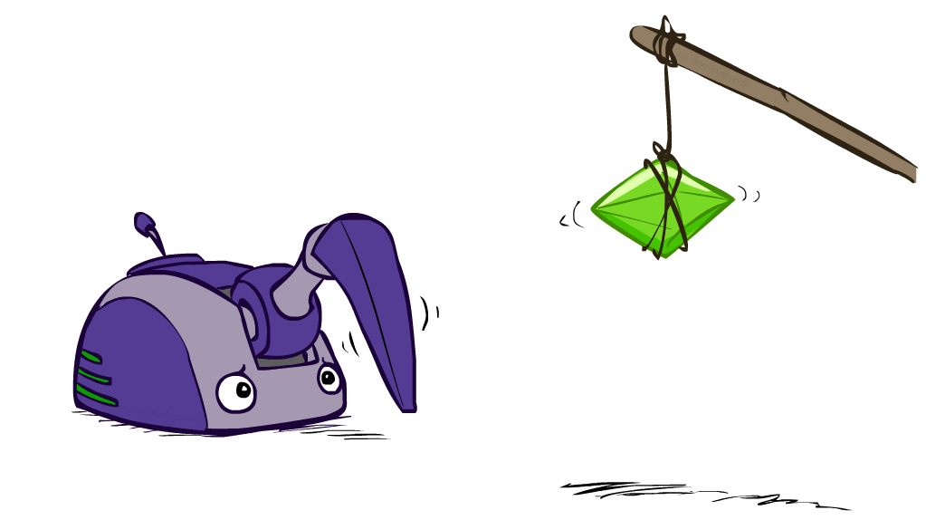
Reinforcement Learning

Slide 19
Reinforcement Learning
Agent
State: s
Reward: r
Actions: a
Environment
Basic idea:
Receive feedback in the form of rewards
Agent’s utility is defined by the reward function
Must (learn to) act so as to maximize expected rewards
All learning is based on observed samples of outcomes!
Notes:
Basic idea: you have an agent who is acting as always. The agent has actions available to it, and chooses and action.
The environment then does what it always does. It resolves the action. It does this with some non-determinism like before. What the agent gets back from the environment is two things. One is the instantaneous reward. The reward can be a bonus or penalty. This is the thing that we want to learn to maximize. The other thing it gets back is a percept. In the simplest formulation this will be the state that it ends up in, later on we’ll see how to relax this.
In this setting, we won’t know what actions will produce what rewards before we try them. Therefore, we have to learn based on experience. This can be characterized as learning from samples.

Slide 20
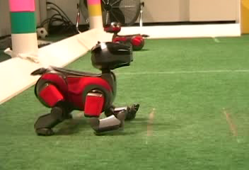

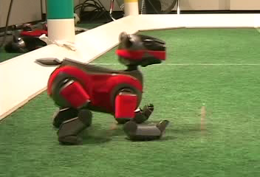
Example: Learning to Walk
Initial
A Learning Trial
After Learning [1K Trials]
[Kohl and Stone, ICRA 2004]
Notes:
Soccer playing AIBOs have to learn at the start of each match how to walk on a new surface.

Slide 21

Example: Learning to Walk
Initial
[Kohl and Stone, ICRA 2004]
[Video: AIBO WALK – initial]
Notes:
Slipping leg. Action is being collected via a camera. Is it making forward progress? It it slipping?

Slide 22
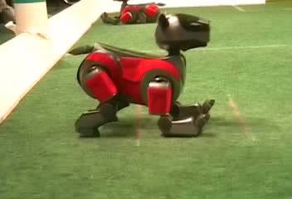
Example: Learning to Walk
Training
[Kohl and Stone, ICRA 2004]
[Video: AIBO WALK – training]
Notes:
During training, it looks like this, which is getting better.

Slide 23

Example: Learning to Walk
Finished
[Kohl and Stone, ICRA 2004]
[Video: AIBO WALK – finished]
Notes:
When the process completes you get a ninja dog that walks faster and is incredibly smooth. And they go on to crush the competition.

Slide 24
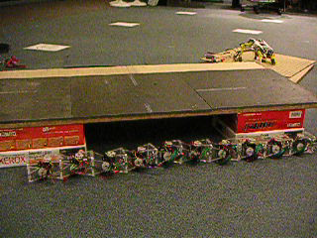
Example: Sidewinding
[Andrew Ng]
[Video: SNAKE – climbStep+sidewinding]

Slide 25

Example: Toddler Robot
[Tedrake, Zhang and Seung, 2005]
[Video: TODDLER – 40s]

Slide 26
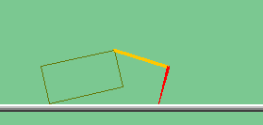
The Crawler!
[Demo: Crawler Bot (L10D1)]
Notes:
At times no reward accumulated at all, just sitting still

Slide 27
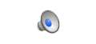
Video of Demo Crawler Bot

Slide 28
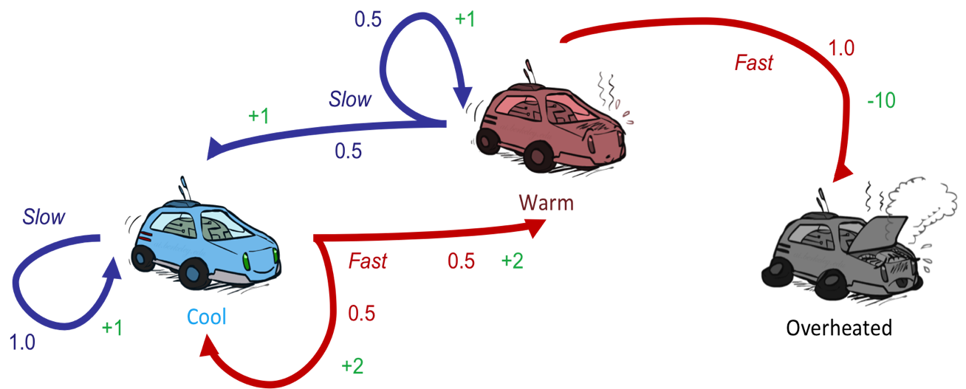
Reinforcement Learning
Still assume a Markov decision process (MDP):
A set of states s ∈ S
A set of actions (per state) A
A model T(s,a,s’)
A reward function R(s,a,s’)
Still looking for a policy π(s)
New twist: don’t know T or R
I.e. we don’t know which states are good or what the actions do
Must actually try actions and states out to learn
Notes:
How is this done?
In reinforcement learning, we still imagine that there’s a MDP. The goal is still to learn a policy.
The new twist is that we don’t know Tor R.

Slide 29
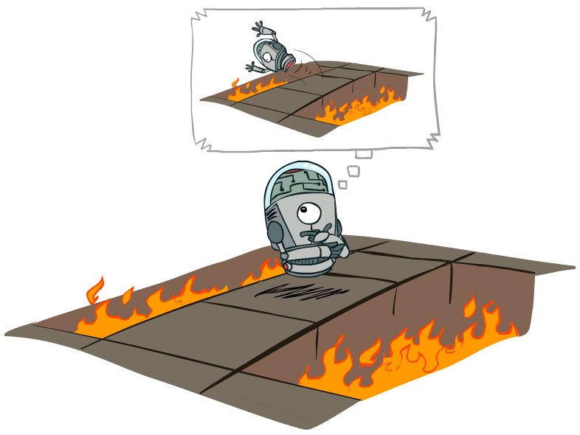
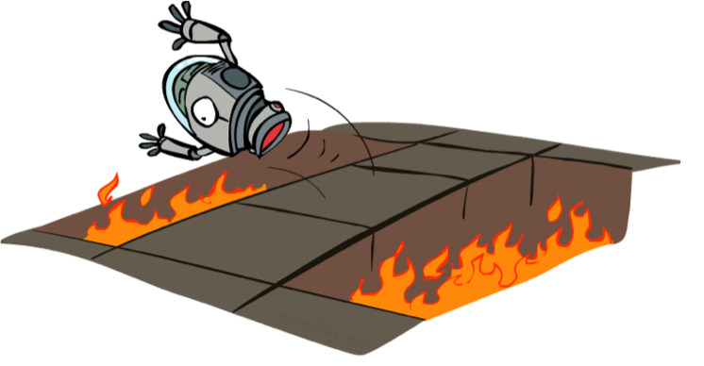
Offline (MDPs) vs. Online (RL)
Offline Solution
Online Learning
Notes:
Offline – in simulation or in your head, you can compute things off and know that it’s bad to jump into the pit.
In online learning, you actually need to take the action.

Slide 30
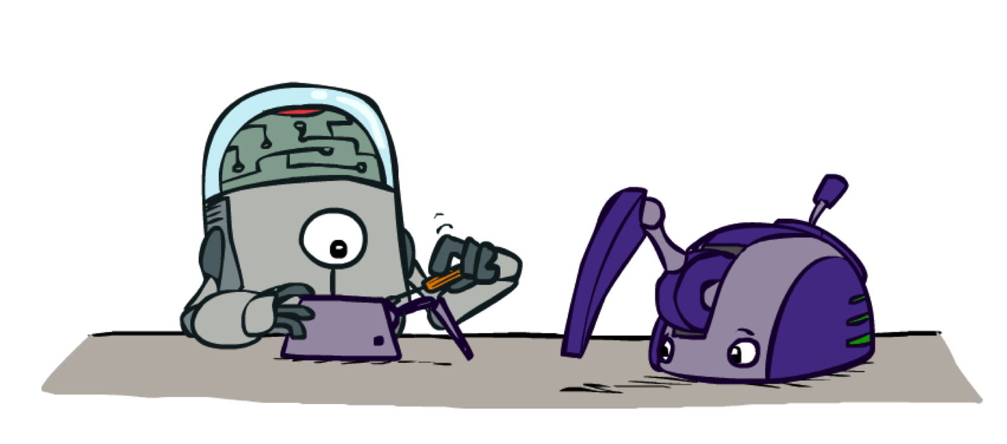
Model-Based Learning
Notes:
In model based learning, we try to figure out the model by learning the transition functions and the rewards. How does that work?

Slide 31

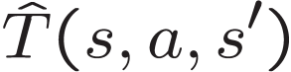

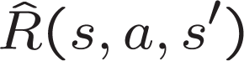
Model-Based Learning
Model-Based Idea:
Learn an approximate model based on experiences
Solve for values as if the learned model were correct
Step 1: Learn empirical MDP model
Count outcomes s’ for each s, a
Normalize to give an estimate of
Discover each when we experience (s, a, s’)
Step 2: Solve the learned MDP
For example, use value iteration, as before
Notes:
We are going to learn an approximate model based on our experiences. Then we’re going to solve for the values as if the learned model were correct.
So how do we do that?
Act for a while. Accumulate counts. Create probabilities. Observe rewards.

Slide 32
Example: Model-Based Learning
Input Policy π
Observed Episodes (Training)
Learned Model
Episode 1
Episode 2
T(s,a,s’).
T(B, east, C) = 1.00
T(C, east, D) = 0.75
T(C, east, A) = 0.25
…
R(s,a,s’).
R(B, east, C) = -1
R(C, east, D) = -1
R(D, exit, x) = +10
…
 | A
B | C | D
 | E
B, east, C, -1
C, east, D, -1
D, exit, x, +10
B, east, C, -1
C, east, D, -1
D, exit, x, +10
Episode 3
Episode 4
E, north, C, -1
C, east, D, -1
D, exit, x, +10
E, north, C, -1
C, east, A, -1
A, exit, x, -10
Assume: γ = 1
Notes:
Someone gives us a policy pi. We say, alright we’re going to do this.
(Here we’re setting the gamma to be one, just to make the example sample).
Ep 1 and 2 are the same.
Ep 3 and 4 are different.
We can then used these observations to compute a model.
The transition from B having selected East results in C 100% of the time.
The transiition from C having picked the action East results in D 75% of the time and A 25% of the time.
Now we have a transition function (probabilities) and the reward function. We now have an MDP. It’s the wrong MDP, but we can solve it.

Slide 33
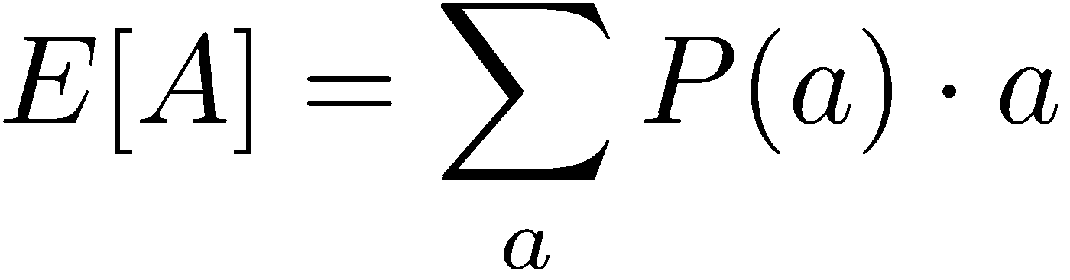
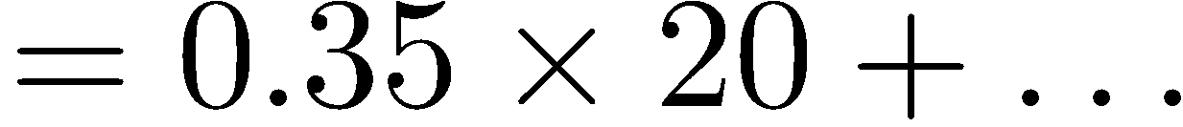
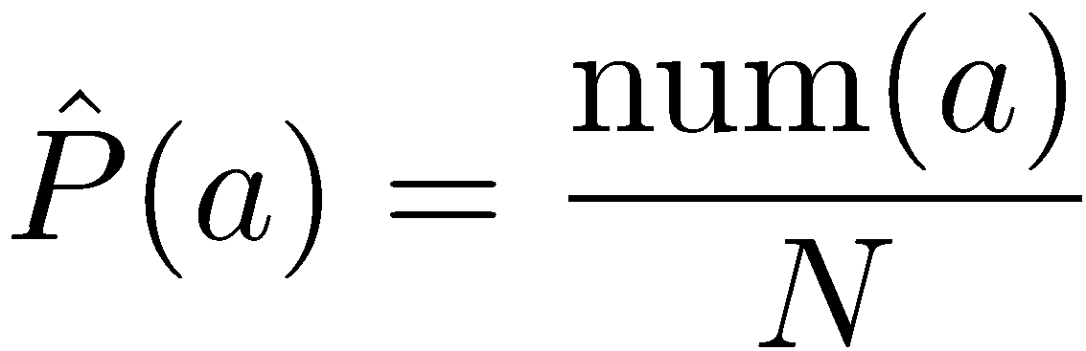
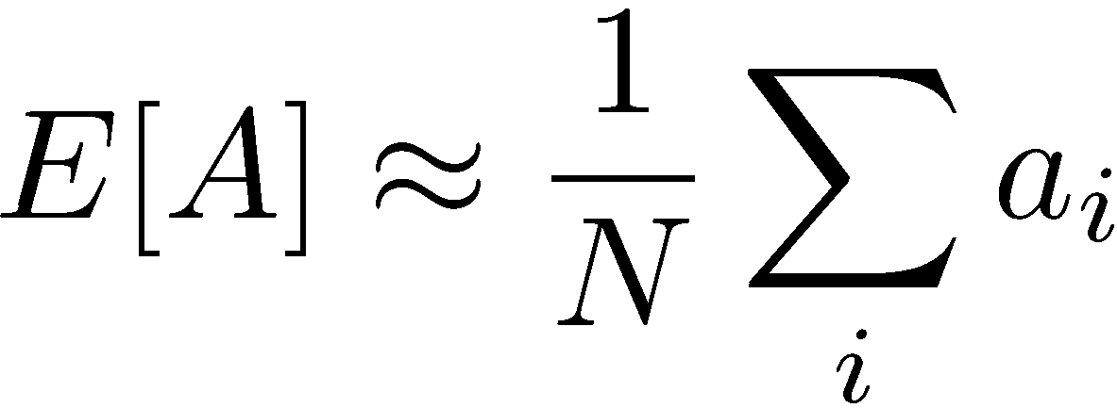
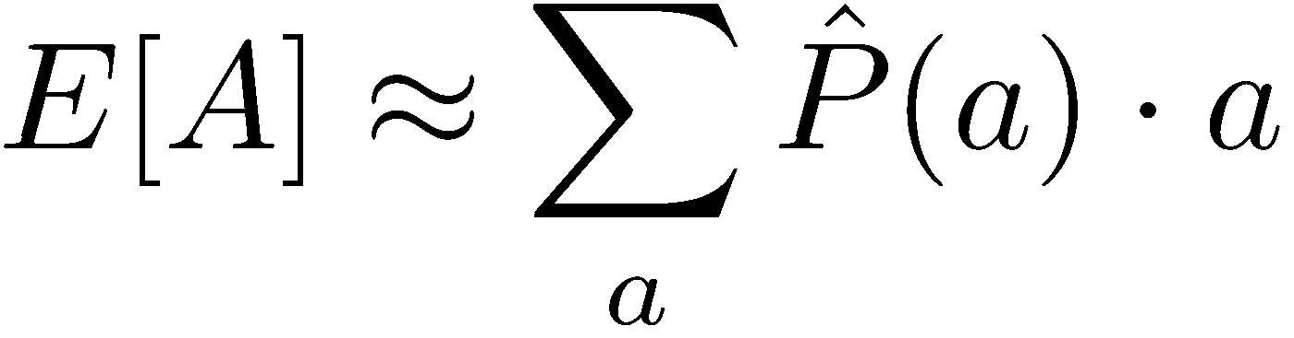
Example: Expected Age
Goal: Compute expected age of CIS 421/521 students
Known P(A)
Without P(A), instead collect samples [a₁, a₂, … a_{N}]
Unknown P(A): “Model Based”
Unknown P(A): “Model Free”
Why does this work? Because eventually you learn the right model.
Why does this work? Because samples appear with the right frequencies.
Notes:
In the model free version we don’t weight by the probability.
But in this case they’re equivalent, since they will appear with the right frequency.
It’s really just a matter of how and when you group things.
In the reinforcement learning there is going ot be a difference because we will take the structure into account. Things are going to depend on the other states around them.
But this gives a good high-level overview of what we mean by model-based v. model free.

Slide 34
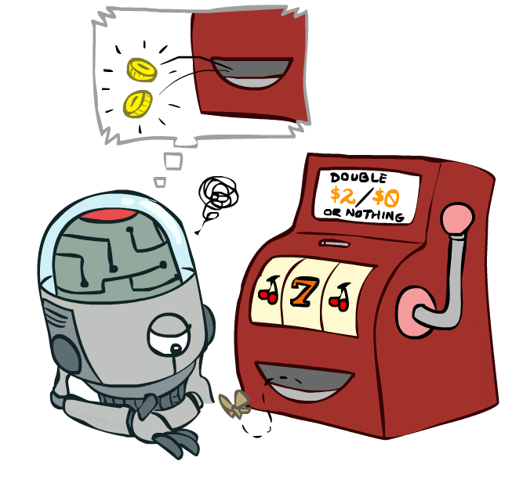
Model-Free Learning
Notes:
now we're going to talk about model free
learning and model free learning we
don't construct a model of the transition function
Instead, we take actions and every time we take an action we compare what we thought was going to happen to what actually did happen.
Whenever something is better or worse than what we expected we adjust our values up and down.
So what we track in a model free approach is the values of interest themselves not the transition functions or the rewards.

Slide 35
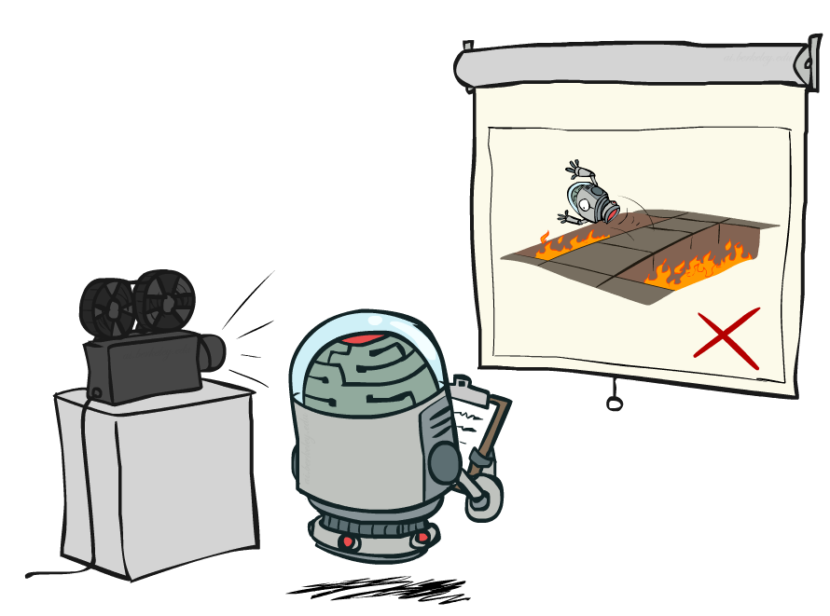
Passive Reinforcement Learning
Notes:
In passive reinfocement learning, someone else chooses the policy. And we observe what happens.
The passive case is this simplified task. We're not going to try to figure out how to act optimally.
We're going try to figure out essentially what policy evaluation did.
The input is a fixed policy. We want to evaluate it.

Slide 36

Passive Reinforcement Learning
Simplified task: policy evaluation
Input: a fixed policy π(s)
You don’t know the transitions T(s,a,s’)
You don’t know the rewards R(s,a,s’)
Goal: learn the state values
In this case:
Learner is “along for the ride”
No choice about what actions to take
Just execute the policy and learn from experience
This is NOT offline planning! You actually take actions in the world.

Slide 37
Direct Evaluation
Goal: Compute values for each state under π
Idea: Average together observed sample values
Act according to π
Every time you visit a state, write down what the sum of discounted rewards turned out to be
Average those samples
This is called direct evaluation

Slide 38
Example: Direct Evaluation
Input Policy π
Observed Episodes (Training)
Output Values
Episode 1
Episode 2
 | A
B | C | D
 | E
 | A
B | C | D
 | E
B, east, C, -1
C, east, D, -1
D, exit, x, +10
B, east, C, -1
C, east, D, -1
D, exit, x, +10
-10
+8
+4
+10
Episode 3
Episode 4
-2
E, north, C, -1
C, east, D, -1
D, exit, x, +10
E, north, C, -1
C, east, A, -1
A, exit, x, -10
Assume: γ = 1
Notes:
We’re given an input policy
We just want to evaluate it.
What utility did I receive from B? Not -1. That was the intentions reward. I want to compute the utility, which is from B until the end. So +8.
Write down what happened.
Why 4 for C? 9 + 9 + 9 - 11 = 16/4 = 4

Slide 39
Problems with Direct Evaluation
What’s good about direct evaluation?
It’s easy to understand
It doesn’t require any knowledge of T, R
It eventually computes the correct average values, using just sample transitions
What bad about it?
It wastes information about state connections
Each state must be learned separately
So, it takes a long time to learn
Output Values
 | A
B | C | D
 | E
-10
+8
+4
+10
-2
If B and E both go to C under this policy, how can their values be different?

Slide 40

Why Not Use Policy Evaluation?
s
Simplified Bellman updates calculate V for a fixed policy:
Each round, replace V with a one-step-look-ahead layer over V
This approach fully exploited the connections between the states
Unfortunately, we need T and R to do it!
Key question: how can we do this update to V without knowing T and R?
In other words, how to we take a weighted average without knowing the weights?
π(s)
s, π(s)
s, π(s),s’
s’

Slide 41
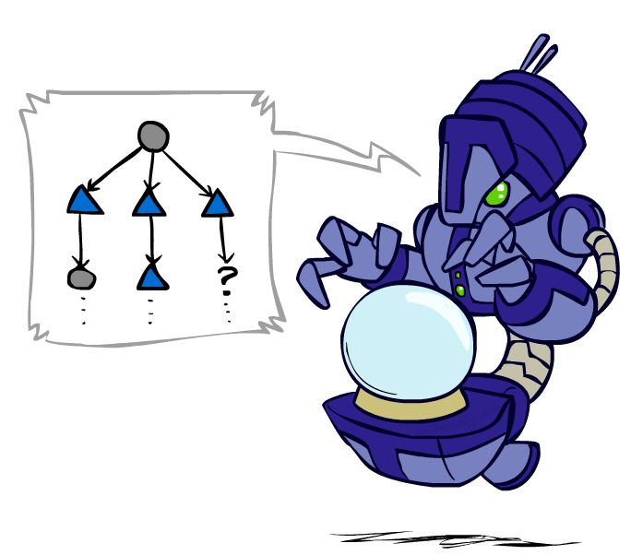
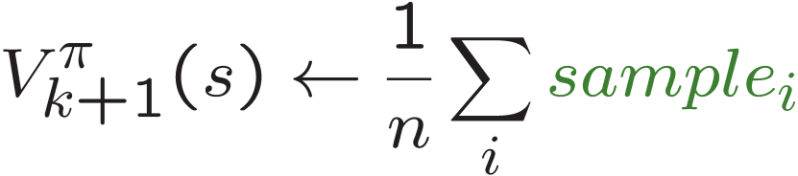
Sample-Based Policy Evaluation?
We want to improve our estimate of V by computing these averages:
Idea: Take samples of outcomes s’ (by doing the action!) and average
s
π(s)
s, π(s)
s, π(s),s’
s₁'
s₂'
s'
s₃'
Almost! But we can’t rewind time to get sample after sample from state s.
Notes:
Can we do sample based policy evaluation?
What’s wrong with this? We don’t get to do lots of actions from state s. We don’t get to rewind and re-do it to get multiple observations.

Slide 42
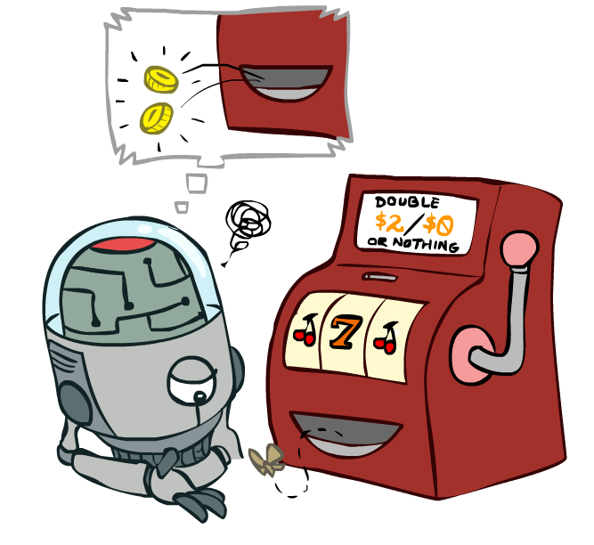
Temporal Difference Learning

Slide 43
Temporal Difference Learning
Big idea: learn from every experience!
Update V(s) each time we experience a transition (s, a, s’, r)
Likely outcomes s’ will contribute updates more often
Temporal difference learning of values
Policy still fixed, still doing evaluation!
Move values toward value of whatever successor occurs: running average
s
π(s)
s, π(s)
s’
Sample of V(s):
Update to V(s):
Same update:
Notes:
The reason this is called temporal difference learning is because we compare our current estimate of a value with what we actually see
Interprolation

Slide 44
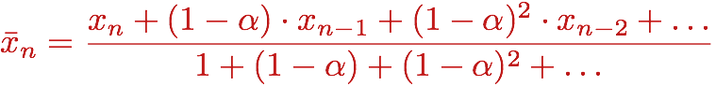
Exponential Moving Average
Exponential moving average
The running interpolation update:
Makes recent samples more important:
Forgets about the past (distant past values were wrong anyway)
Decreasing learning rate (alpha) can give converging averages

Slide 45
Example: Temporal Difference Learning
States
Observed Transitions
B, east, C, -2
C, east, D, -2
 | A
B | C | D
 | E
 | 0
0 | 0 | 8
 | 0
 | 0
-1 | 0 | 8
 | 0
 | 0
-1 | 3 | 8
 | 0
Assume: γ = 1, α = 1/2

Slide 46
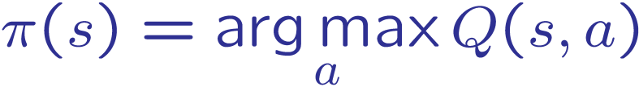
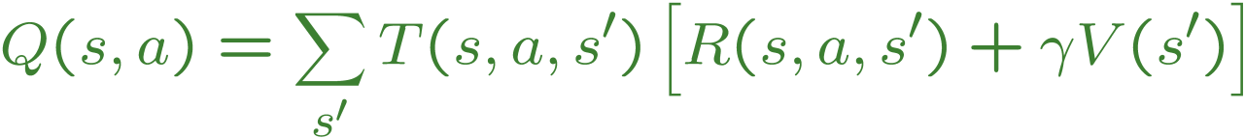
Problems with TD Value Learning
TD value leaning is a model-free way to do policy evaluation, mimicking Bellman updates with running sample averages
However, if we want to turn values into a (new) policy, we’re sunk:
Idea: learn Q-values, not values
Makes action selection model-free too!
s
a
s, a
s,a,s’
s’

Slide 47
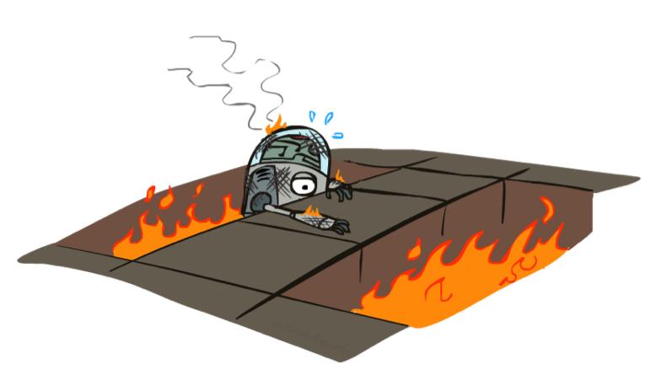
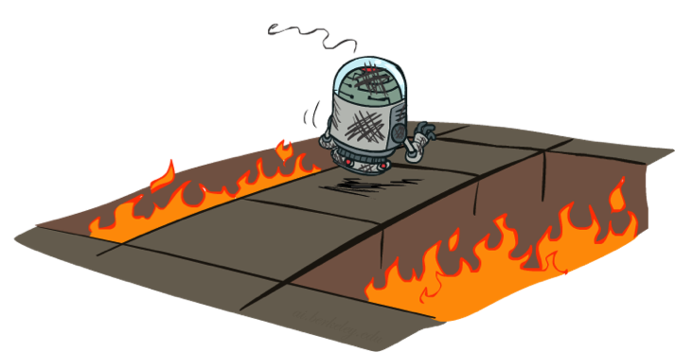
Active Reinforcement Learning

Slide 48
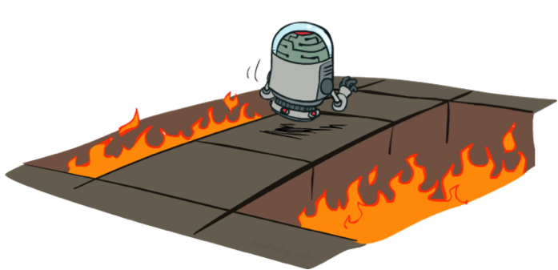
Active Reinforcement Learning
Full reinforcement learning: optimal policies (like value iteration)
You don’t know the transitions T(s,a,s’)
You don’t know the rewards R(s,a,s’)
You choose the actions now
Goal: learn the optimal policy / values
In this case:
Learner makes choices!
Fundamental tradeoff: exploration vs. exploitation
This is NOT offline planning! You actually take actions in the world and find out what happens…

Slide 49
Detour: Q-Value Iteration
Value iteration: find successive (depth-limited) values
Start with V₀(s) = 0, which we know is right
Given V_{k}, calculate the depth k+1 values for all states:
But Q-values are more useful, so compute them instead
Start with Q₀(s,a) = 0, which we know is right
Given Q_{k}, calculate the depth k+1 q-values for all q-states:

Slide 50
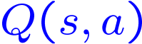
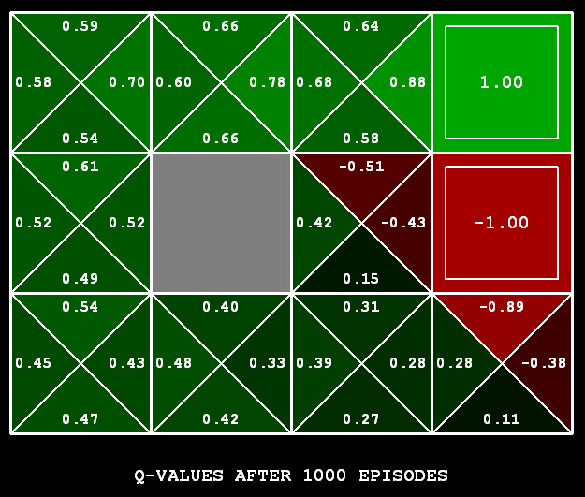
Q-Learning
Q-Learning: sample-based Q-value iteration
Learn Q(s,a) values as you go
Receive a sample (s,a,s’,r)
Consider your old estimate:
Consider your new sample estimate:
Incorporate the new estimate into a running average:
[Demo: Q-learning – gridworld (L10D2)]
[Demo: Q-learning – crawler (L10D3)]

Slide 51
Video of Demo Q-Learning -- Gridworld

Slide 52
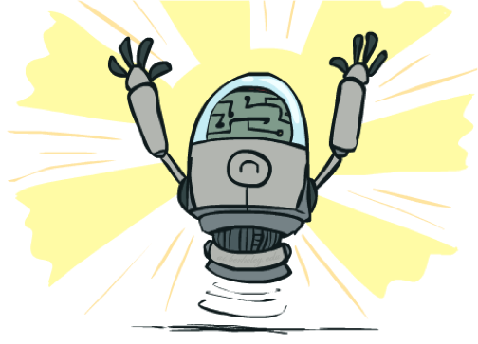
Q-Learning Properties
Amazing result: Q-learning converges to optimal policy -- even if you’re acting suboptimally!
This is called off-policy learning
Caveats:
You have to explore enough
You have to eventually make the learning rate
small enough
… but not decrease it too quickly
Basically, in the limit, it doesn’t matter how you select actions (!)

